Slide 1
StyleHub
Assessing Contrastive Learning for Fashion Recommendations
IE 7295: Master’s Project
Rida Khan (002804008)

Slide 2
TABLE OF CONTENTS
01
02
03
04
Introduction
Problem
Solution
Conclusion
Background
Motivation
- Generating Recommendations
Approach
Results
Summary
Future Work

Slide 3
01
Introduction
This section gives us a background and motivation for our study

Slide 4
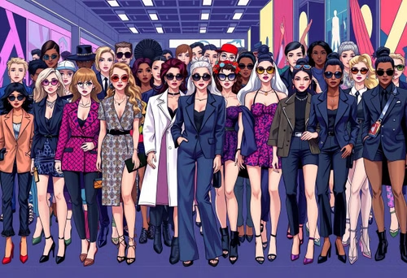
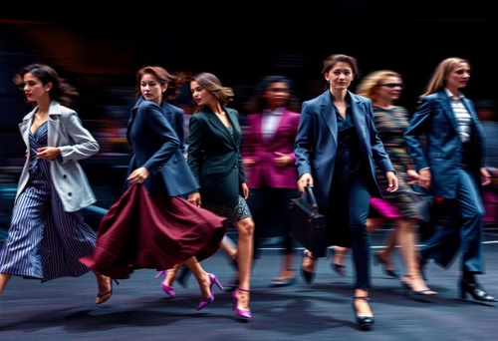
Background
Traditional Methods:
Collaborative Filtering(CF)
Content Based Filtering(CBF)
Hybrid Approach
Wide Range of Styles
Issues:
Cold Start
Limited Adaptability
Rapidly changing trends in fashion

Slide 5
Motivation
Using Contrastive Learning for personalized recommendations because it:
Captures Visual and Semantic Nuances
Addresses Data Sparsity and Cold-Start Issues

Slide 6
02
Problem
Can we use contrastive learning to generate personalised fashion recommendations? How?

Slide 7
03
Solution
Create strong item representations by comparing similar and different items.
Transactional Approach
Embedding Approach
Group similar items together and push dissimilar items apart, ensuring better recommendations.

Slide 8




Dataset : HM Personalized Fashion Recommendations (kaggle)
Images
articles.csv
A directory containing photos for each article, organized by the first three digits of each article id.
A metadata file for each article, including attributes such as product type, color, and seasonality.
customers.csv
transactions_train.csv
A file containing metadata for each customer, including demographic and behavioral data.
The dataset, recording each customer purchase. Duplicate values represent multiple purchases of the same item on a given day.

Slide 9

Data Preprocessing Steps
EDA & Cleaning
Understand the Data through Visualizations
Handle Missing Values
Handle Unwanted Columns
Prepare the final dataset for training

Slide 10
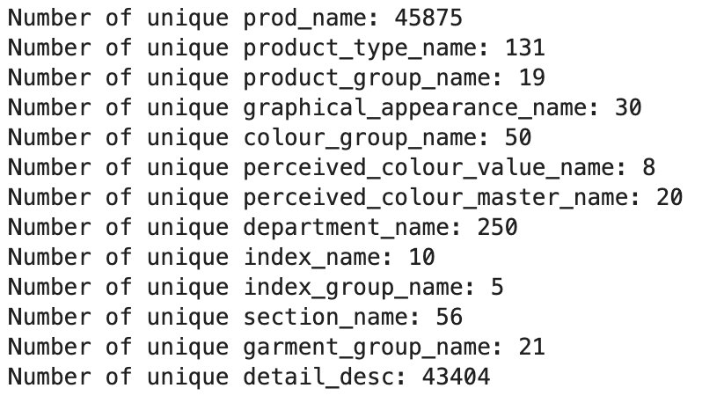
Data Preprocessing Steps
articles

Slide 11
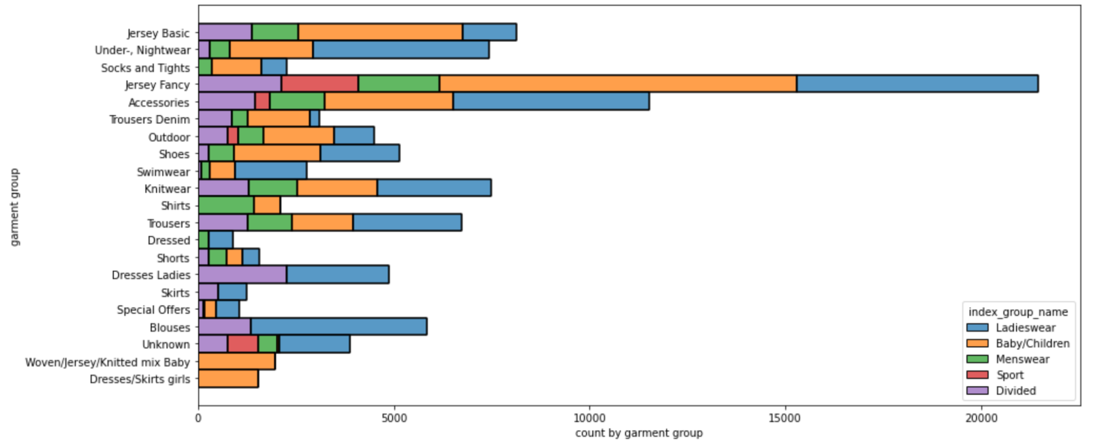
Data Preprocessing Steps
articles

Slide 12
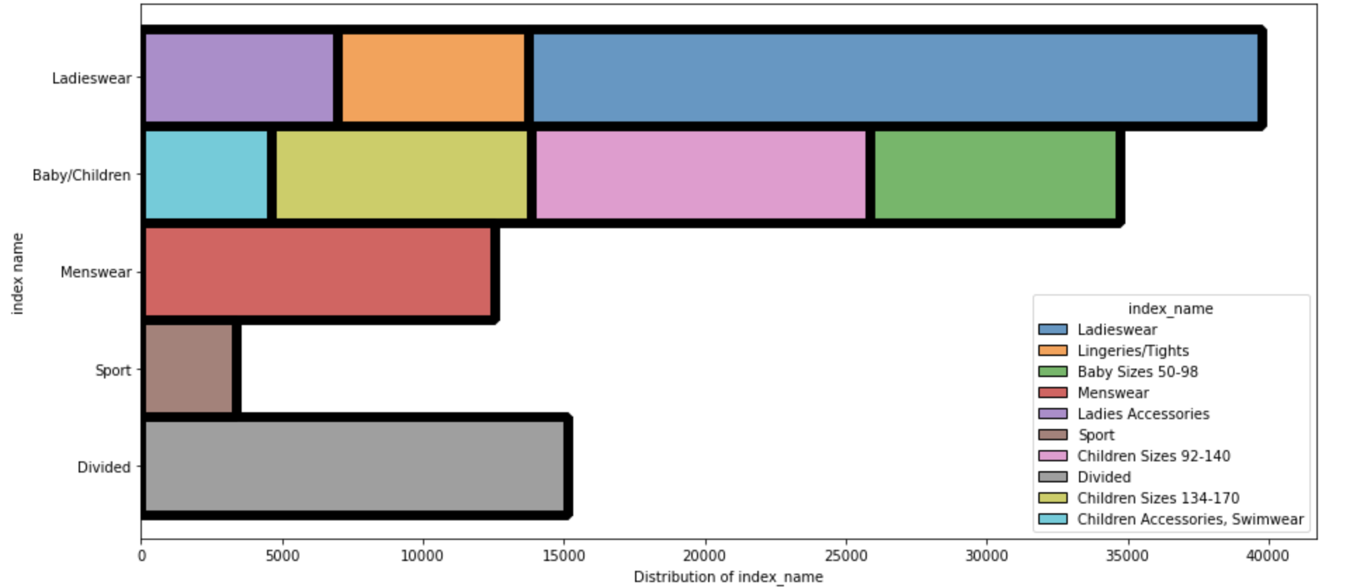
Data Preprocessing Steps
articles

Slide 13
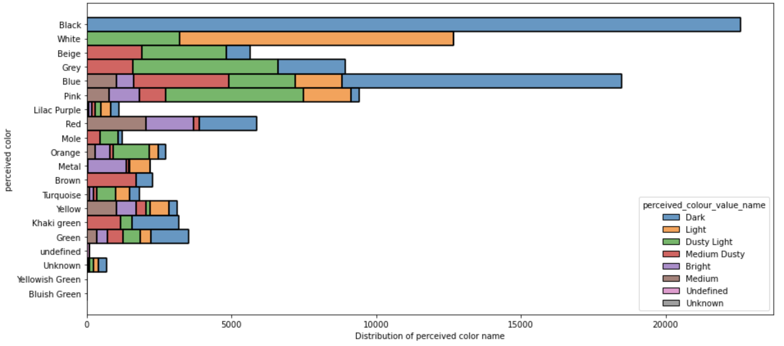
Data Preprocessing Steps
articles

Slide 14
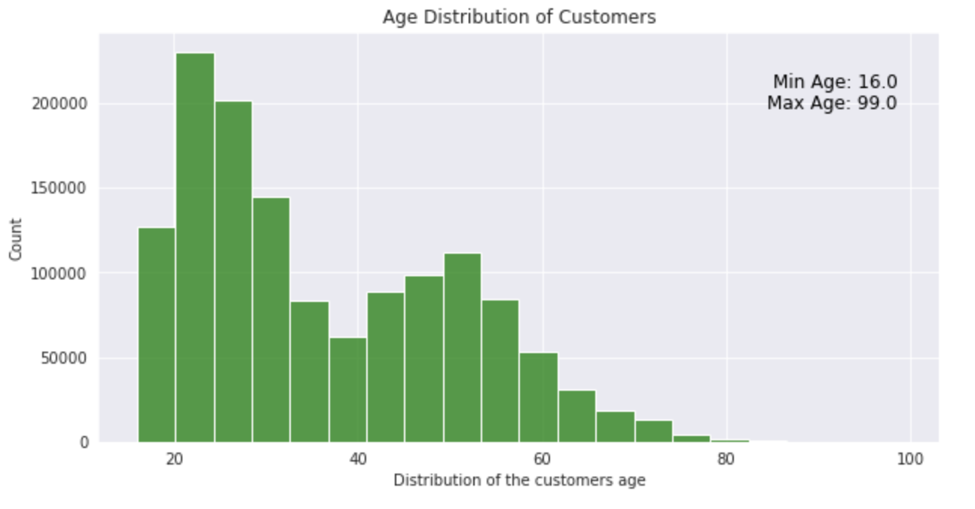
Data Preprocessing Steps
customers

Slide 15
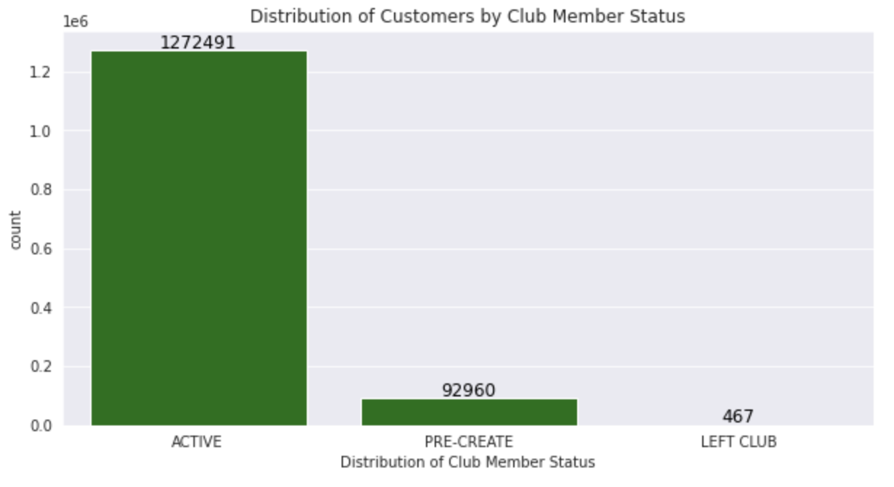
Data Preprocessing Steps
customers

Slide 16
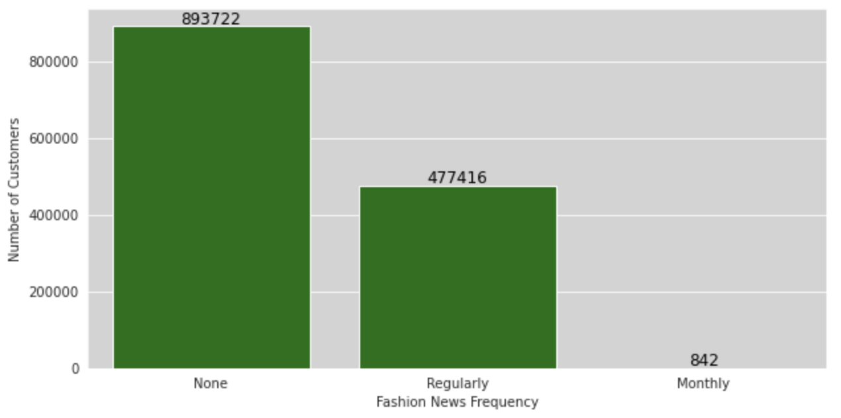
Data Preprocessing Steps
customers

Slide 17
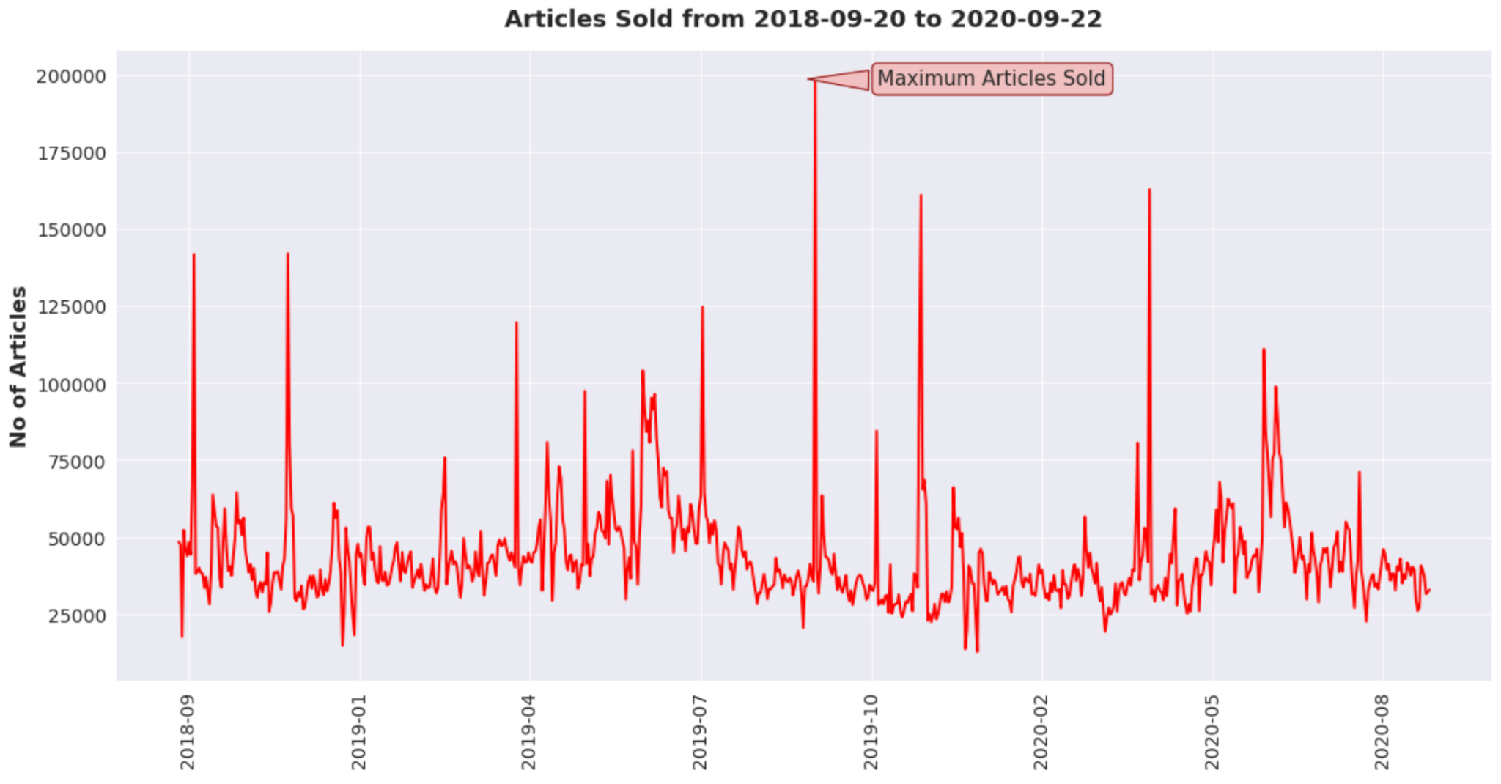
Data Preprocessing Steps
transactions

Slide 18
The Contrastive Model

Slide 19
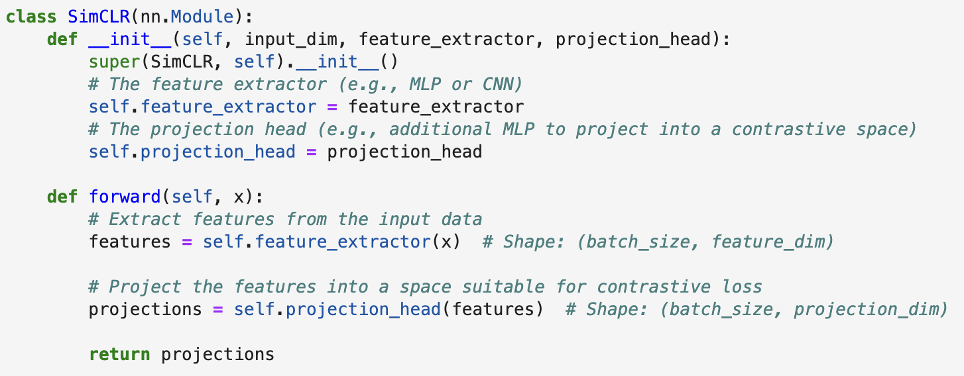
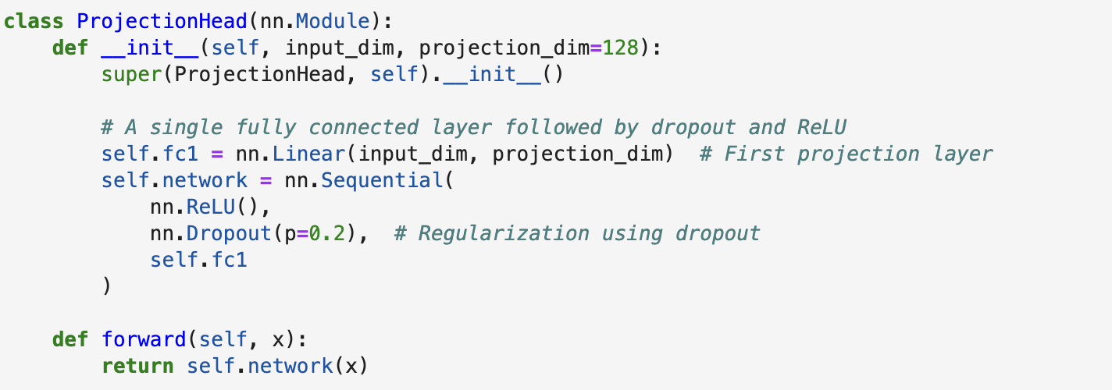

Slide 20
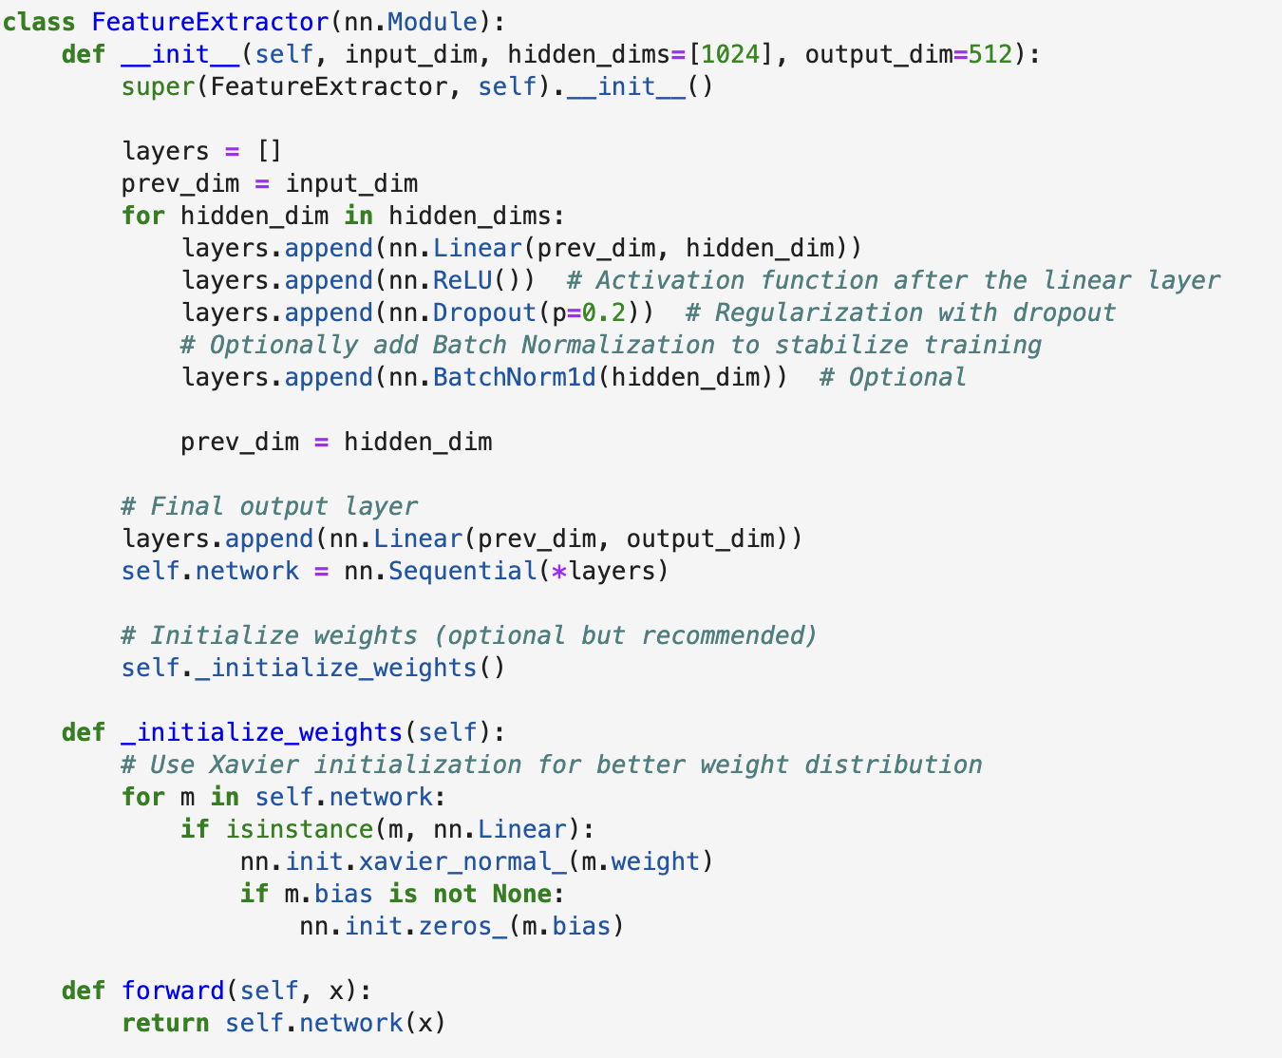
Model Components
Feature Extractor
Extract features from training data to build the contrastive dataset

Slide 21
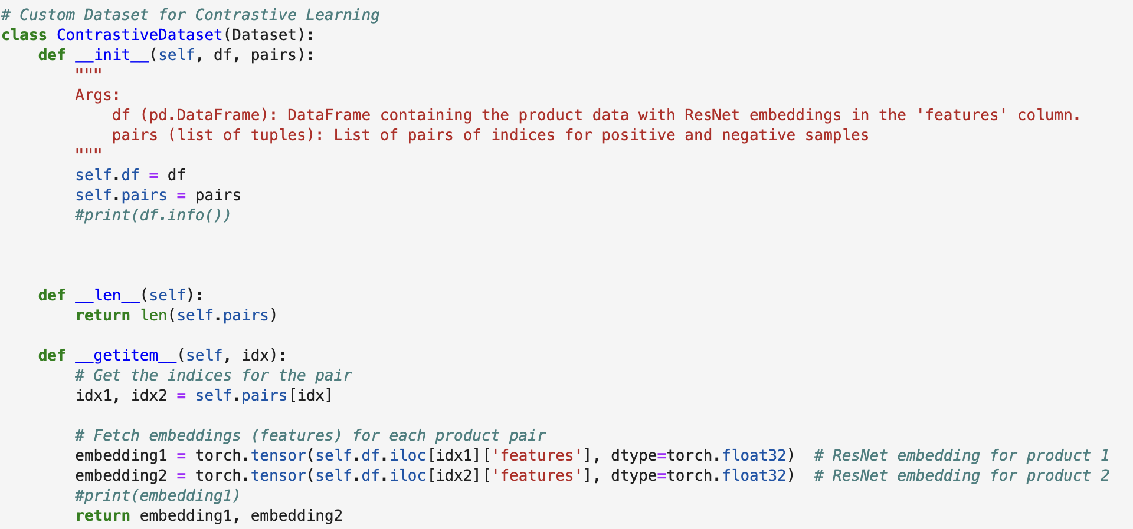
Model Components
Contrastive Dataset
This is a class that ensures the right dataset is constructed to pass through the contrastive model

Slide 22
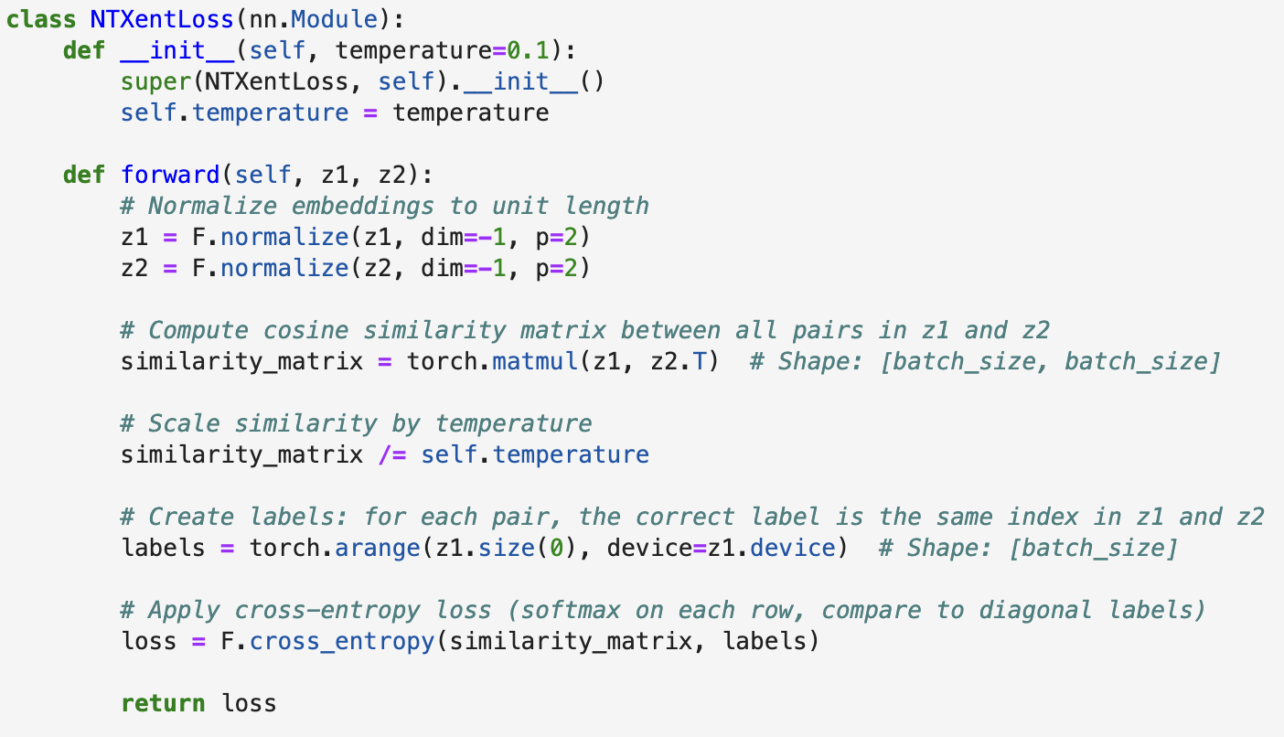
Model Components
Loss Function
Using NT XENT loss function to reduce the distance between similar items and increase the distance between dissimilar ones

Slide 23
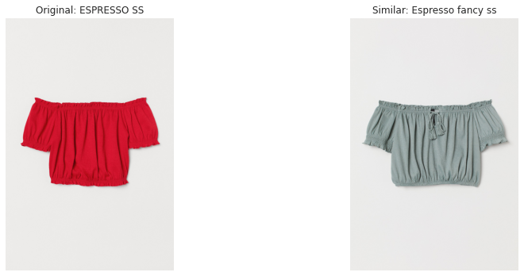

Model Architecture - Training
The model takes in the feature vector from the feature extractor and processes it through two hidden layers, which reduce its dimensionality.
Maximise Similarity between embeddings
Encoder
Projection
Item pairs
Hidden layers

Slide 24


Approach 1: Using Prior Transaction History For Pair Generation
Positive Pairs: Items bought together or closely in time, suggesting preference similarity.
Negative Pairs: Items the customer never purchased, indicating dissimilarity.
This approach was dropped due to model decay. There are no similarities or close to none when it comes to embeddings of articles, hence making this approach unusable with contrastive learning.

Slide 25
Approach 2: Using Item Data For Pair Generation
Positive Pairs: Created using similar textual embeddings of items
Negative Pairs: Unrelated textual embeddings of items
This approach was used for the personalized recommender due its successful performance.

Slide 26
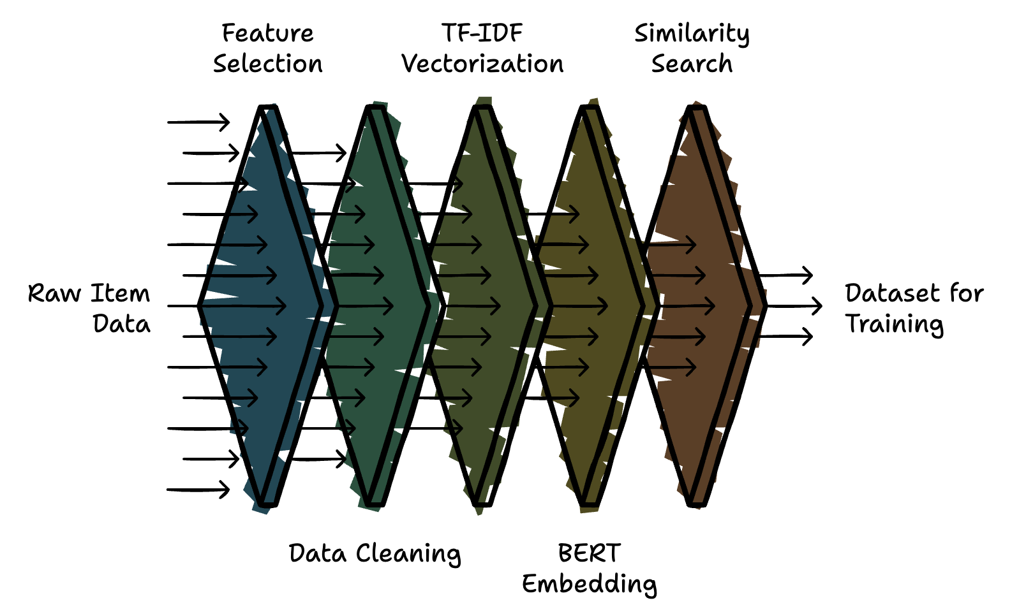
Approach 2: Step by Step
This approach resulted in a total of 246,226 pairs, which we split into an 80-20 training and testing set.
The training set consisted of 196,981 pairs, while the test set included 49,245 pairs.
Notes:
Select Descriptive Features: Chose key item attributes like product group, type, color, garment group, and detailed description.
Data Cleaning: Preprocessed the data by converting text to lowercase, removing non-alphanumeric characters, tokenizing, and eliminating stopwords and repetitive words.
TF-IDF Vectorization: Converted cleaned text into feature vectors, capturing the most significant words (max 500 words per item).
BERT Embedding: Passed TF-IDF vectors through BERT to generate high-quality, semantically rich embeddings for each item.
Similarity Search with FAISS: Used FAISS to find the 5 most similar items based on BERT embeddings, forming positive pairs.
Negative Pair Generation: Randomly selected items that were not among the 5 most similar, creating negative pairs for contrast.
Dataset Creation: Formed a dataset of 246,226 pairs, split into 80% for training (196,981 pairs) and 20% for testing (49,245 pairs).
Training: Applied contrastive learning on the dataset to learn effective item embeddings.

Slide 27
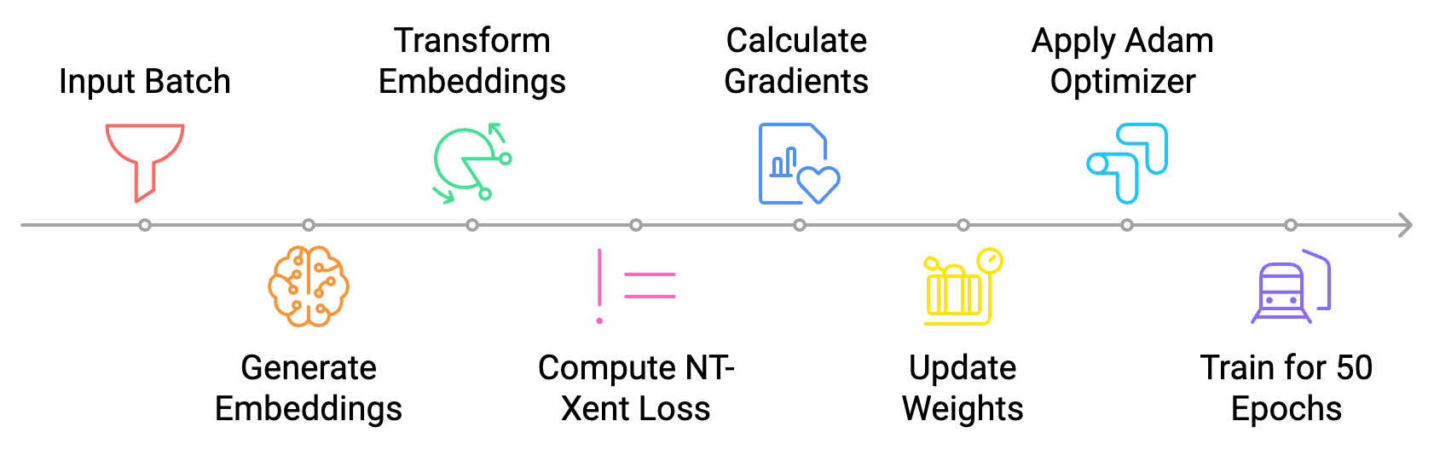
Training
Notes:
Input: A batch of item pairs (text descriptions or image embeddings) is fed into the model.
Feature Extraction: The model generates embeddings for each item in the pair.
Projection: The embeddings are transformed into a suitable space for contrastive learning.
Loss Calculation: NT-Xent loss is computed using cosine similarity between the item pair projections.
Backpropagation: Gradients are calculated and used to update the model weights.
Optimization: Adam optimizer updates model parameters with a learning rate of 0.001 and CosineAnnealingLR for learning rate scheduling.
Training Setup: The model is trained for 50 epochs with a batch size of 256.

Slide 28
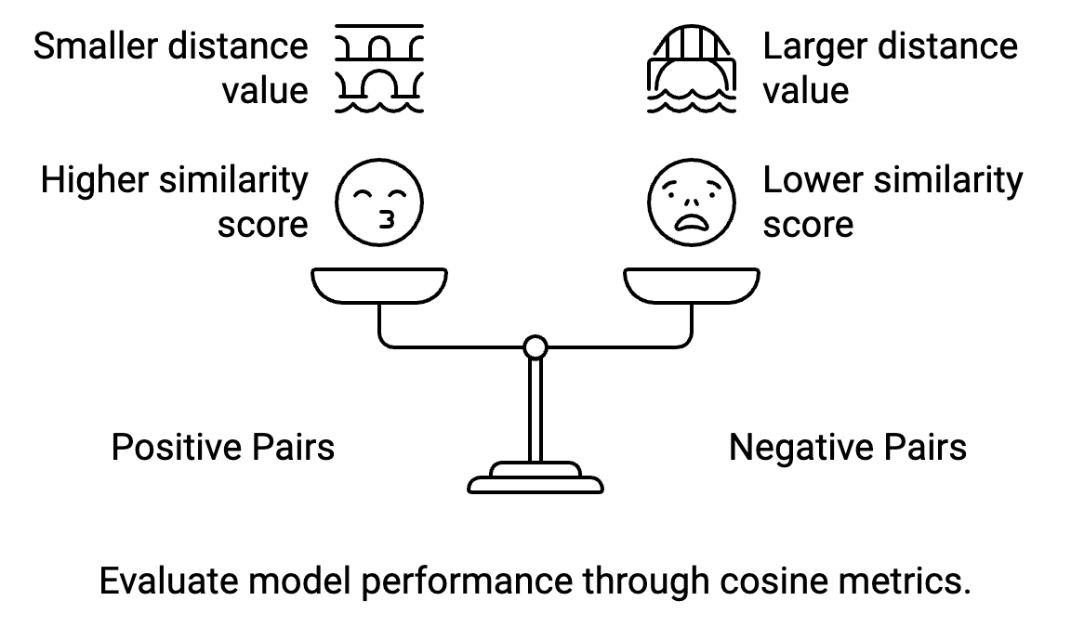
Evaluation and Results

Slide 29
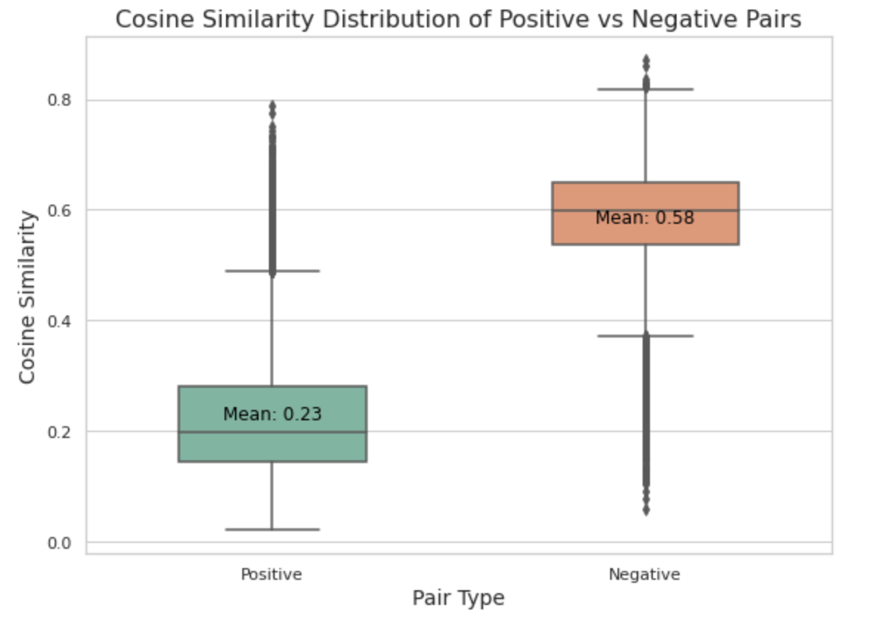
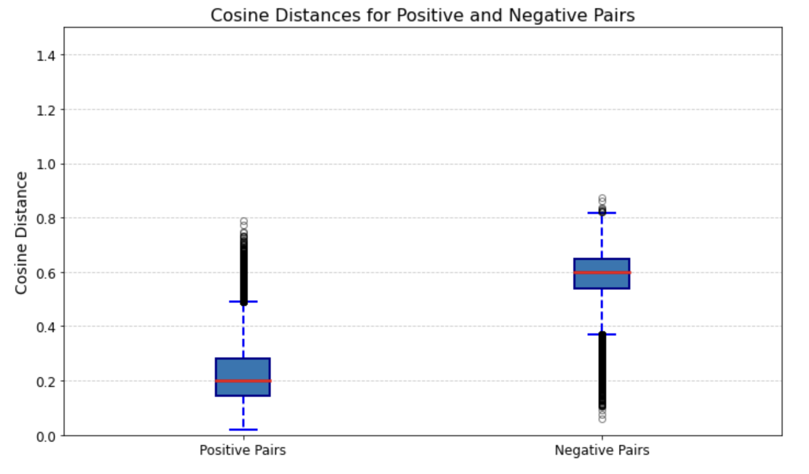
Evaluation and Results
After 50 epochs of training, the contrastive learning model showed a significant increase in the distance between positive and negative pairs. Specifically, the average cosine distance for positive pairs (0.2286) was much smaller compared to that for negative pairs (0.5849), indicating that the model successfully learned to differentiate between similar and dissimilar items.
Notes:
After 50 epochs of training, the contrastive learning model showed a significant increase in the distance between positive and negative pairs. Specifically, the average cosine distance for positive pairs (0.2286) was much smaller compared to that for negative pairs (0.5849), indicating that the model successfully learned to differentiate between similar and dissimilar items.
The substantial difference in cosine distances between the positive and negative pairs confirms that the contrastive learning approach effectively minimized the distance for similar items while maximizing it for dissimilar items, achieving the desired behavior of the model after 50 epochs.

Slide 30
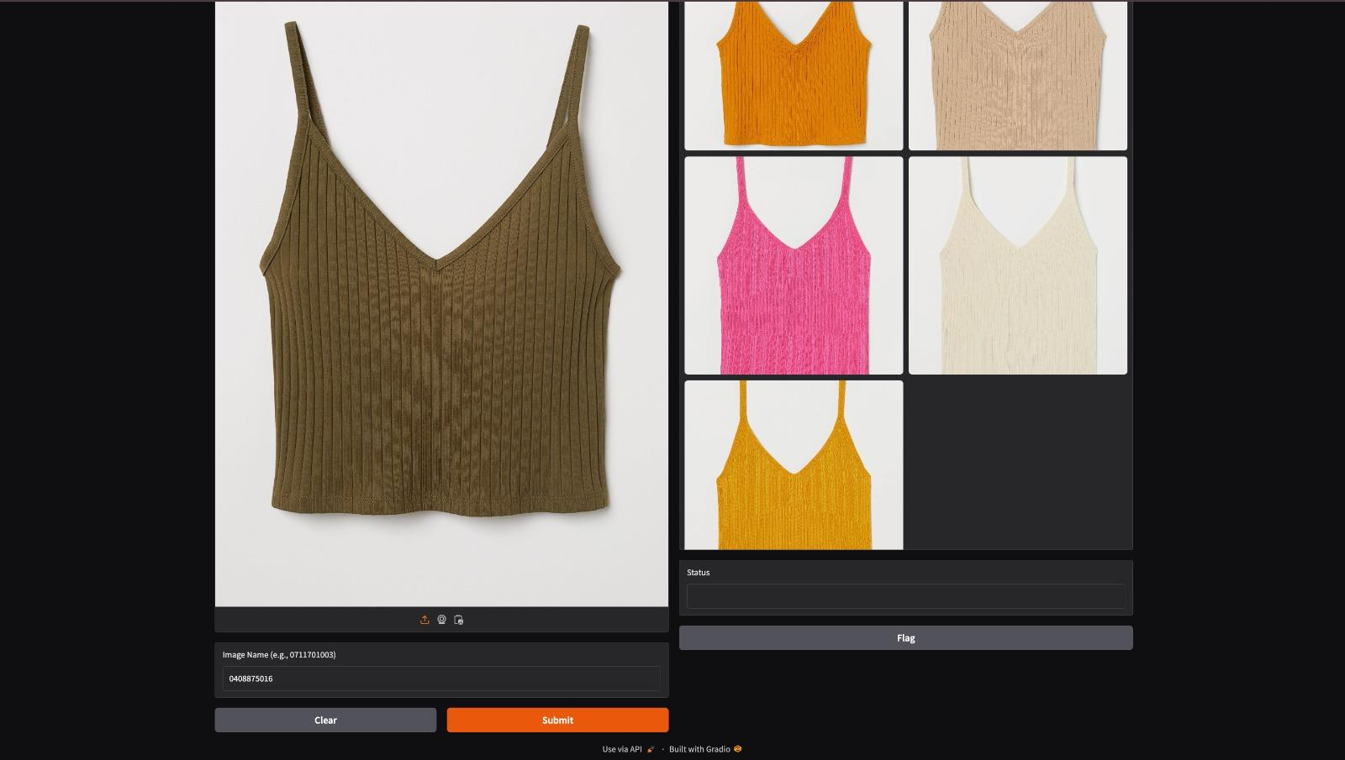
STYLEHUB FRONTEND
Takes in an image input with name and shows similar apparel. This is great for a personalized fashion use case.

Slide 31


Slide 32
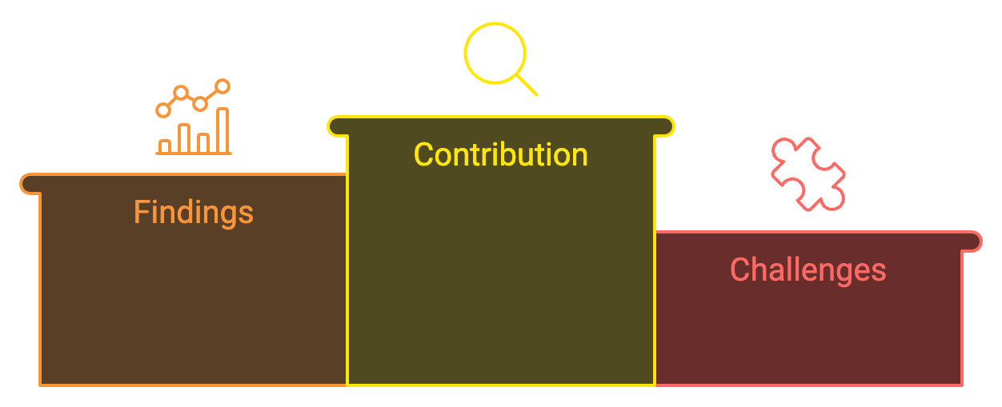
Conclusion
Transactional data showed limitations, leading to model decay.
Item description-based embeddings generated more accurate and diverse positive pairs.
Provides insights for enhancing recommendation systems in fashion, offering a foundation for future research.
Misalignment between textual descriptions and visuals impacted pair generation.
Study Focus
Explored contrastive learning for fashion recommendations using transactional and item data.

Slide 33
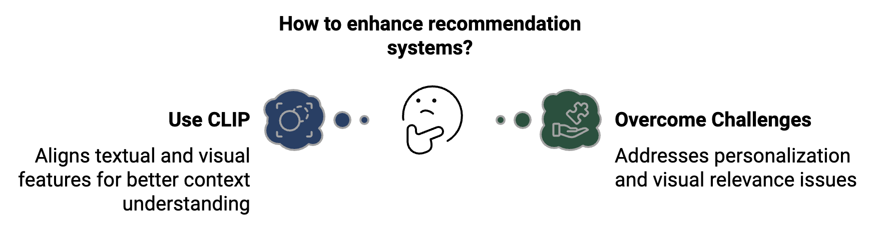
Conclusion

Slide 34
THANKS
DO YOU HAVE ANY QUESTIONS?
khan.rida@northeastern.edu

